Slide 1
Using Deep Learning Platforms to Perform Inference over Knowledge Bases
William W Cohen
Google AI/Carnegie Mellon University
joint work with
Fan Yang, Zhilin Yang, Kathryn Rivard Mazaitis

Slide 2


Clean understandable elegant models
Complexity of real-world phenomena
⇒
complex models
⇒
lots of programming or data
Notes:
Logic is elegant, but the real world is complex

Slide 3

Complexity of real-world phenomena
⇒
complex models
⇒
lots of programming or data
How did we get here?
Notes:
Logic is elegant, but the real world is complex

Slide 4
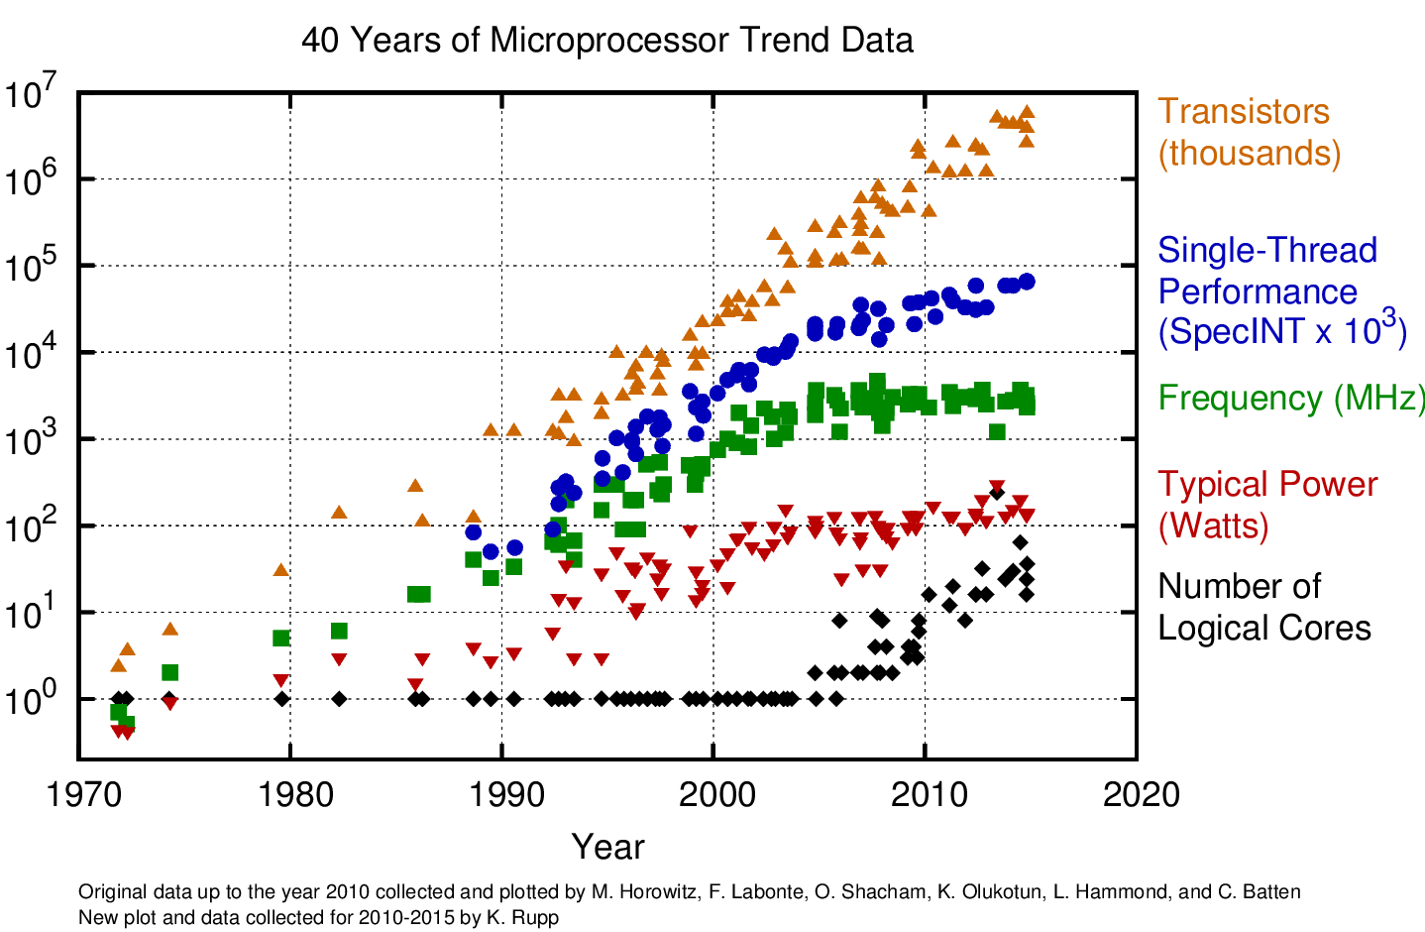
Notes:
Logic is elegant, but the real world is complex

Slide 5
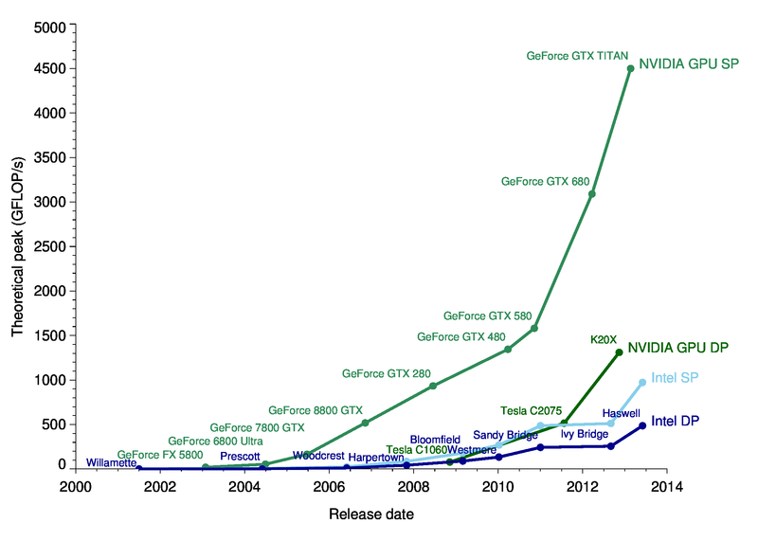
How did we get here?
2017: 45 Teraflops
(45,000 GFLOPS)
Notes:
Logic is elegant, but the real world is complex

Slide 6

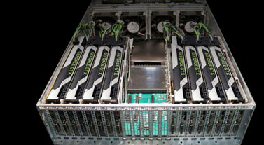
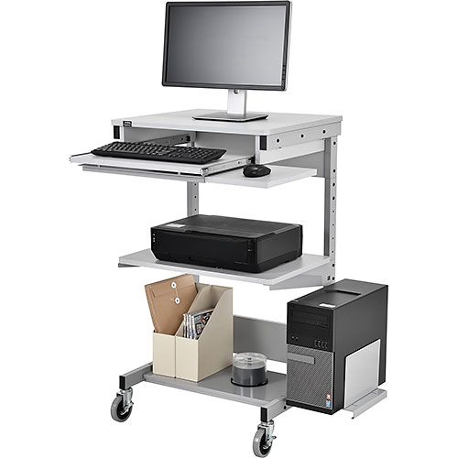
run Hadoop, Spark, ...
How did we get here?
run a big pile of linear algebra
Notes:
Logic is elegant, but the real world is complex

Slide 7
Example of what neural nets can do
Essex rounded Cape Horn in January 1820 after a five-week transit, which was extremely slow. Combined with the unsettling earlier incident, the crew began to talk of ill omens. …
Task for trained system: formulate a question based on this passage with answer January 1820
Result: ….?
Notes:
when did the captain of the essex land in the pacific?

Slide 8
Inference for
Probabilistic KBs
Easily Integrated with ML
Deep Learning Platforms
Notes:
Logic is elegant, but the real world is complex

Slide 9
Tensorlog:
Key ideas and background

Slide 10
TensorLog
Background: Probabilistic DDBs

Slide 11
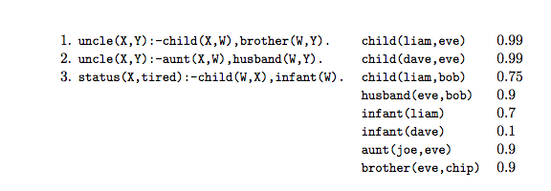
Probabilistic Deductive DBs
see [Suciu et al, 2011]
Horn clauses (rules)
ground unit clauses (facts)
weight for each fact

Slide 12
Probabilistic Deductive DBs
status(X,tired) :- child(W,X), infant(W), weighted(r3).
We use this trick to weight rules
weighted(r3) 0.98
special fact only appearing in this rule
special fact only appearing in this rule

Slide 13
Probabilistic Deductive KGs
(Knowledge Graphs)
Assumptions:
(Only parameters are weights for facts)
Predicates are unary or binary
Rules have no function symbols or constants

Slide 14
TensorLog
Background
Probabilistic DDBs
Complexity of inference in Pr DDBs

Slide 15
Semantics for PrDDB
One common approach: model-counting where conceptually
There is a distribution Pr(DB) over DBs
E.g. tuple-independence: draw a DB by picking each fact f independently with probability w_{f}
The probability of a fact f’ is the probability T+DB’ implies f’, for a DB’ drawn from Pr(KG)
E.g.: ProbLog, Fuhr’s Probabilistic Datalog (PD), ...

Slide 16
Probabilistic Deductive DBs
sample
Pr(DB) = 0.99 * 0.99 * (1-0.75) * 0.9 * 0.7 * (1-0.1) * 0.9 * 0.9
~= 0.1125

Slide 17
Probabilistic Deductive DBs
sample
Pr(DB) = 0.99 * 0.99 * 0.75 * 0.9 * 0.7 * (1-0.1) * (1-0.9) * 0.9
~= 0.0375
Pr(fact | Theory, soft DB) = Pr(fact | Theory, hard DB) Pr(hard DB | soft DB)

Slide 18
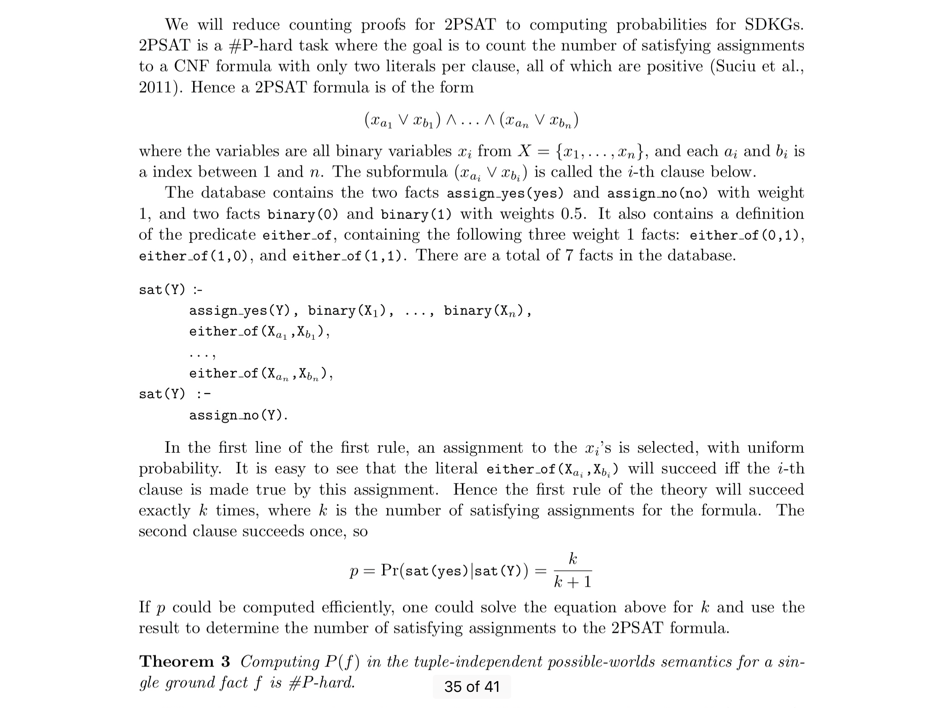
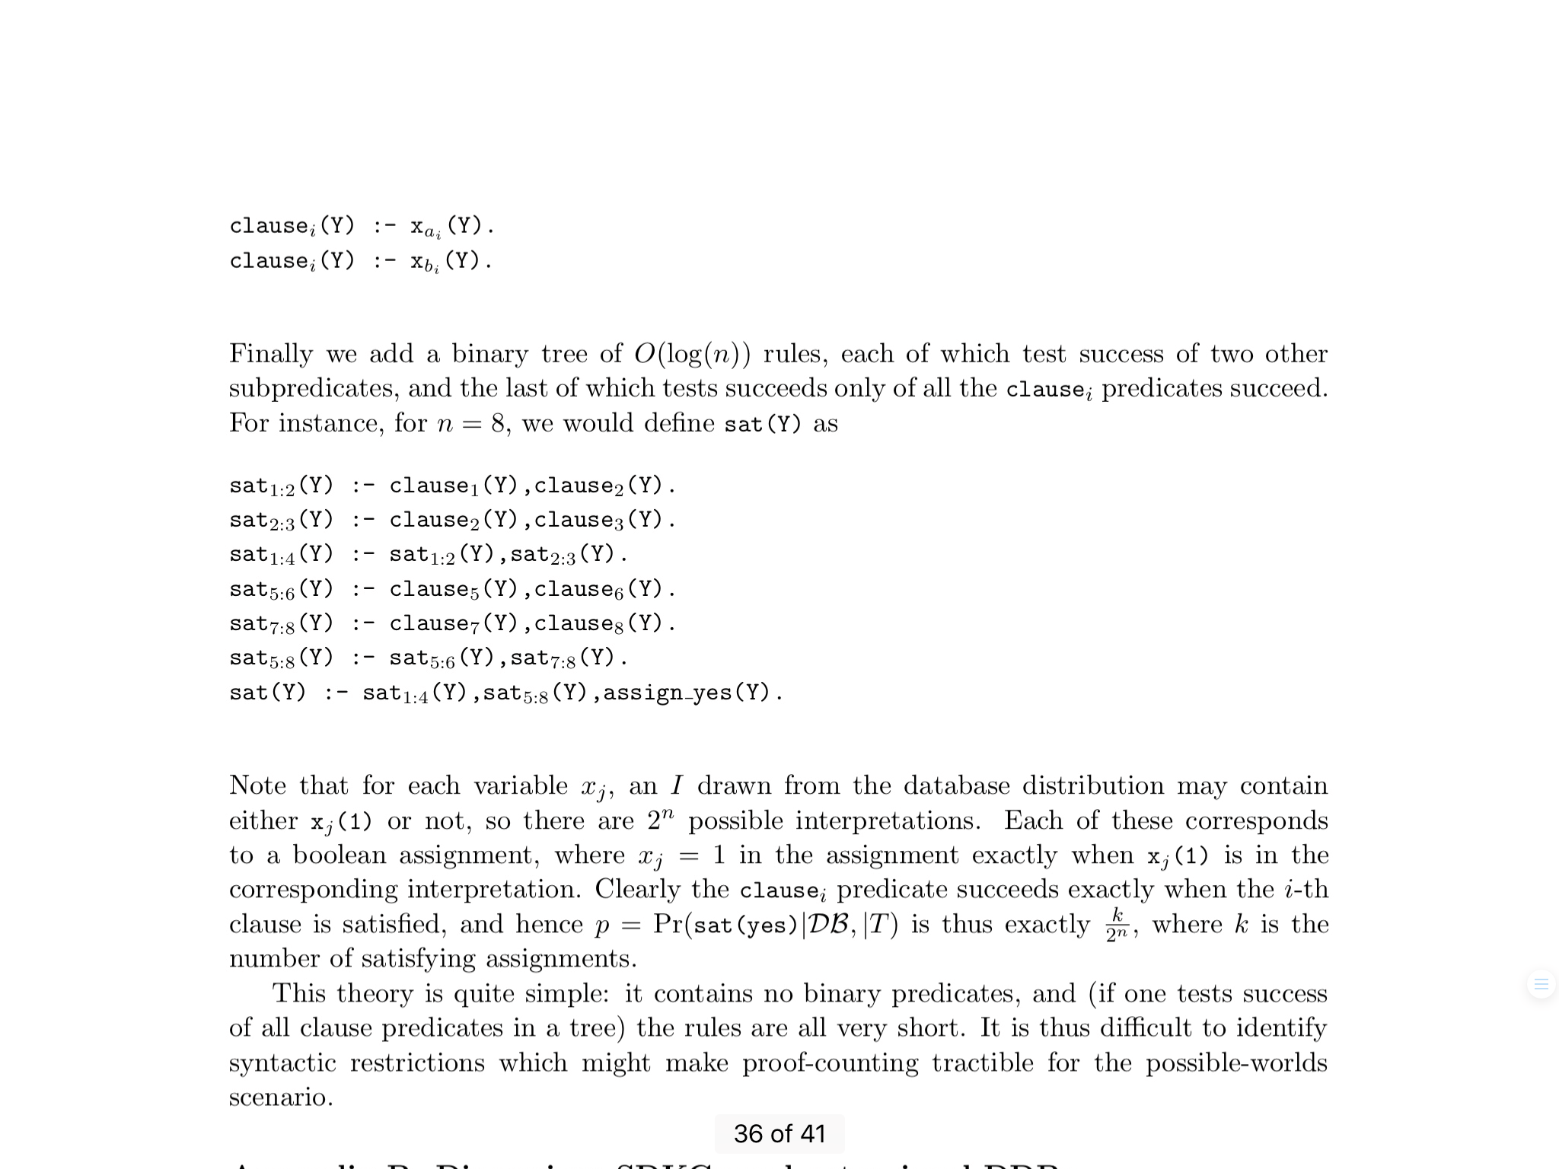
Semantics for PrDDB
Bad news: it’s very hard to syntactically restrict PrDDB’s so that this semantics is tractable. Even very simple cases are #P-hard.
Reduction from 2PSAT*:
see [Suciu et al, 2011]
n of these, one for each clause
DB
x₁(1) | 0.5
x₂(1) | 0.5
... | ...
x_{m}(1) | 0.5
log n rules AND the clause_{i} ‘s
together
Only unary predicates, and each rule has <= 2 literals in body!
*2PSAT (SAT with 2-literal clauses with only positive literals) is #P-hard

Slide 19
Semantics for PrDDB: Take 2
Another approach is proof-counting
For each answer a to query Q, find all derivations d_{a} that prove a
The weight of each d_{a} is product of weight w_{f} of each KG fact f used in that derivation
The weight of a is the sum of the weights of all derivations
Intuition: probability that a random proof succeeds.
Eg: unnormalized stochastic logic programs (SLP) - Cussens and Muggleton 2001.

Slide 20
Semantics for PrDDB
A problem: It’s very easy to have exponentially many proofs!
p(X,Y) :- q(X,Z1), q(Z1,Z2), ...., q(Zn,Y).
q(U,V) :- r1(U,V).
q(U,V) :- r2(U,V).

Slide 21
Semantics for PrDDB
More bad news: Proof-counting for PrDDBs is also #P-hard!
Reduction from 2PSAT:
DB
assign_yes(y) | 1.0
assign_no(n) | 1.0
either_of(0,1) | 1.0
either_of(1,0) | 1.0
either_of(1,1) | 1.0
binary(0) | 0.5
binary(1) | 0.5
Only unary/binary predicates and constant-size DB

Slide 22
TensorLog
Background
Probabilistic DDBs
Complexity of inference in Pr DDBs
Model-counting: #P-hard
Proof-counting: #P-hard
Any tractable subsets?
Yes!
More background: factor graphs

Slide 23
Factor graphs for proof-counting
“x ⇔ w”
“w ⇒ y”
Factor 1
X | W
0 | 0 | 0.99
0 | 1 | 0.01
1 | 0 | 0.01
1 | 1 | 0.99
X
factor1
W
factor2
Y
Round nodes are random variables that can take on one of several discrete values -- e.g. {0,1}
Square nodes are factors that assign weight to combinations of the variables they are connected to.
Joint distribution depends on factors:
Factor 2
W | Y
0 | 0 | 1.0
0 | 1 | 1.0
1 | 0 | 0.0
1 | 1 | 1.0
Prob(X=x, W=w, Y=y) ∝ factor1(x,w) * factor2(w,y)

Slide 24
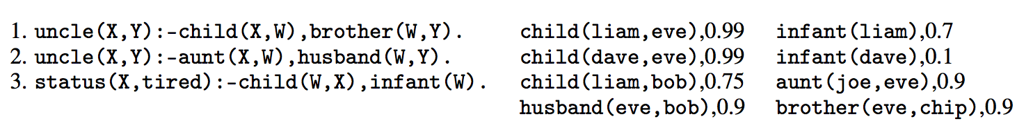
Factor graphs for proof-counting
Query: uncle(liam, Y) ?
BP is an iterative message-passing method. When does it converge quickly?
uncle(X,Y) :- parent(X,W),brother(W,Y)
X
W
brother
Y
parent
Inference algorithm:
Build a factor graph with one random variable for each logical variable, and one factor for each logical literal.
Inputs are “evidence variables” in the factor graph (eg X=liam)
Belief propagation (BP) on factor graph enforces the logical constraints of a proof, and gives a weighted count of number of proofs supporting each answer

Slide 25
Factor graphs for proof-counting for PrDDBs
uncle(X,Y) :- parent(X,W),brother(W,Y)
parent
X | W
jo | william | 0.9
jo | susan | 1.0
liz | rachel | 1.0
... | ... | ...
X
parent
W
brother
Y
Random variables range over DB constants and correspond to logical variables
Factors are based on sets of weighted unit facts with same predicate
If you map constants to integers, a factor can be encoded with a sparse matrix
brother
W | Y
rachel | william | 0.8
sarah | william | 1.0
jo | charles | 0.9
... | ... | ...
Prob(X=x, W=w, Y=y) ∝ parent(x,w) * brother(w,y)

Slide 26
Factor graphs for proof-counting for PrDDBs
uncle(X,Y) :- parent(X,W),brother(W,Y)
parent
X | W
jo | william | 0.9
jo | susan | 1.0
liz | rachel | 1.0
... | ... | ...
X
parent
W
brother
Y
Random variables range over DB constants and correspond to logical variables
Factors are based on sets of weighted unit facts with same predicate
If you map constants to integers, a factor can be encoded with a sparse matrix
brother
W | Y
rachel | william | 0.8
sarah | william | 1.0
jo | charles | 0.9
... | ... | ...
Prob(X=x, Y=y) ∝ 𝚺_{w} Pr(w) parent(x,w) * brother(w,y)

Slide 27
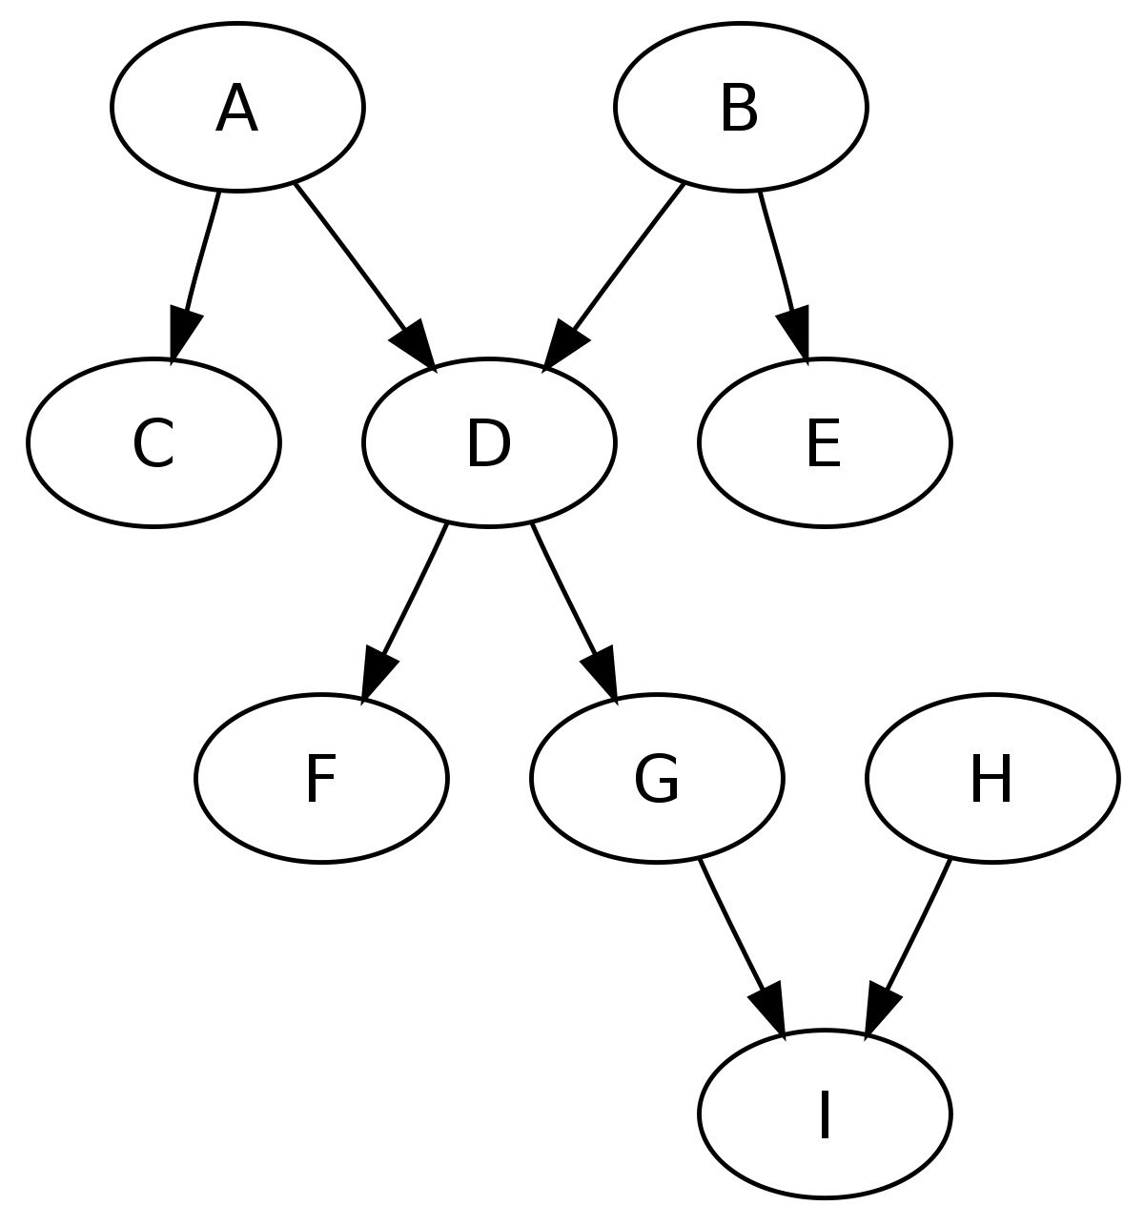
Factor graphs for proof-counting
BP is an iterative message-passing method. When does it converge quickly?
Well-known case: when the graph is a polytree (exactly one undirected path between any pair of nodes)
J

Slide 28
Factor graphs for proof-counting
Query: uncle(liam, Y) ?
uncle(X,Y) :- parent(X,W),brother(W,Y)
BP converges here (or on any chain query)
X
W
brother
Y
parent

Slide 29
Reasoning via message-passing: example
Query: uncle(liam, Y) ?
What does BP do here?
uncle(X,Y):-parent(X,W),brother(W,Y)
X
W
brother
Y
parent
…
[liam=1]
[eve=0.99,bob=0.75]
[chip=0.99*0.9]

Slide 30
Reasoning via message-passing: example
Query: uncle(liam, Y) ?
What does BP do here?
uncle(X,Y):-parent(X,W),brother(W,Y)
Key point: everything in the graph to the left of W is summarized by the message:
[eve=0.99, bob=0.75]
so you can use dynamic programming to count proof efficiently
X
W
brother
Y
parent
[eve=0.99,bob=0.75]
Subproblems: how many proofs of brother(w,Y) are there given than w=eve, w=bob, …. ?

Slide 31
TensorLog
Background
Probabilistic DDBs
Complexity of inference in DDBs
Model-counting: #P-hard
Proof-counting: #P-hard
More background: factor graphs
TensorLog
Pr DDB over a KG (binary predicates)
Clauses correspond to polytrees
...

Slide 32
Factor graphs for proof-counting
Query: uncle(liam, Y) ?
uncle(X,Y):-aunt(X,W),spouse(W,Y)
aunt(X,Y):-parent(X,W),sister(W,Y)
Extension:
Nested predicate calls can be expanded in place in the factor graph
Equivalently: call subroutine to count the proofs for aunt
X
W
spouse
Y
aunt
X’
W’
sister
Y’
parent

Slide 33
Factor graphs for proof-counting
Query: uncle(liam, Y) ?
uncle(X,Y) :- parent(X,W),brother(W,Y)
uncle(X,Y) :- aunt(X,W),spouse(W,Y)
aunt(X,Y):-parent(X,W),sister(W,Y)
This is not a polytree but you can still summarize all the proof counts between X and Y
W1
W
Y
X1
spouse
Y1
aunt
brother
parent
x
Y
X2
W2
spouse
Y2
aunt
X3
W3
sister
Y3
parent

Slide 34
Factor graphs for proof-counting
Query: uncle(liam, Y) ?
uncle(X,Y) :- parent(X,W),brother(W,Y)
uncle(X,Y) :- aunt(X,W),spouse(W,Y)
aunt(X,Y):-parent(X,W),sister(W,Y)
aunt(X,Y):-uncle(X,W),spouse(W,Y)
Can expand recursive clauses out to fixed maximum depth (return zero for all proof counts when it gets too deep)
W1
W
Y
X1
spouse
Y1
aunt
brother
parent
X
Y
X2
W2
spouse
Y2
aunt
W3
W
Y
X5
spouse
Y3
aunt
sister
parent
X4
Y5
X6
W4
spouse
Y4
uncle

Slide 35
Reasoning via message-passing: subpredicates
Query: uncle(liam, Y) ?
uncle(X,Y):-aunt(X,W),spouse(W,Y)
aunt(X,Y):-parent(X,W),sister(W,Y)
Recursive predicate calls can be expanded in place in the factor graph
Multiple clauses for the same predicate: add the proof counts for each clause
X
W
spouse
Y
aunt
X’
W’
sister
Y’
parent
sum
X’’
W’
spouse
Y’’
uncle

Slide 36
TensorLog summary
PrDDB with binary and unary predicates only
Ie, DB is a knowledge graph
Each clause is a polytree
Syntactic restriction on patterns of variable binding
Every free variable has one path linking it to a bound variable
Multiple clauses and fixed-depth recursion are allowed
Inference time and storage under the proof-counting semantics is linear in
Number of triples in KG (size of factors as sparse matrices)
Number of constants in KG (size of message vectors in BP)
Size of the theory
Depth of recursion

Slide 37
TensorLog
Background
Probabilistic DDBs
Complexity of inference in Pr DDBs
TensorLog: tractible case of Pr DDB
Pr DDB over a KG (binary predicates)
Clauses correspond to polytrees
TensorLog and deep learning platforms

Slide 38
TensorLog on Deep Learning Platforms
BP is an algorithm - how can we convert it to a fixed network?
If all clauses are polytrees (then BP converges in linear time and will result in a fixed sequence of messages being passed
BP uses a small set of operations in message-passing
vector-matrix multiplication
Hadamard product
multiply v1 by L1 norm of v2
vector sum
vector L1-normalization

Slide 39
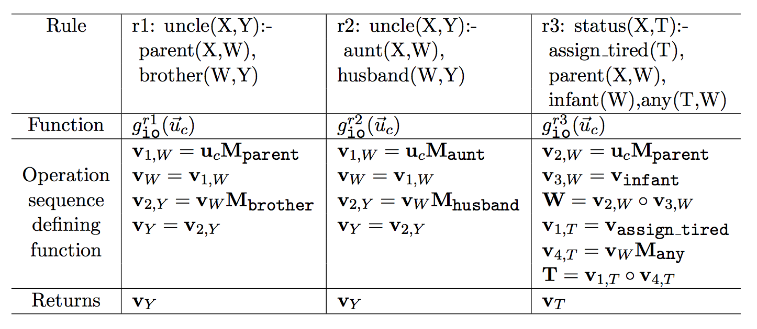
The result of this message-passing sequence produced by BP is just a numeric function; all the steps are differentiable; and all the operations can be implemented in Tensorflow, Theano, pyTorch,...

Slide 40
TensorLog on Deep Learning Platforms
BP converges in linear time and will result in a fixed sequence of messages being passed
Simulate BP to construct that sequence
BP uses a small set of operations in message-passing
Use the sequence from BP to constructed a fixed model for your platform
Learning and inference: use whatever machinery is provided by the platform
Distributed computing, etc: use whatever machinery is provided by the platform

Slide 41
Tensorlog:
Learning Algorithms

Slide 42
Learning in TensorLog
Inference is now via a numeric function: y = g_{io}^{uncle}(u_{a})
y encodes {b:uncle(a,b)} is true and y[b]=confidence in uncle(a,b)
Define loss function relative to target proof-count values y* for x, eg
loss(g_{io}^{uncle}(u_{a}), y*) = crossEntropy(softmax(g(x)),y*)
Minimize the loss with gradient-descent, ….
To adjust weights for selected DB relations, e.g.: dloss/dM_{brother}

Slide 43
Key point: Learning is “free” in TensorLog
Inference is now via a numeric function: y = g_{io}^{uncle}(u_{a})
y encodes {b:uncle(a,b)} is true and y[b]=confidence in uncle(a,b)
Define loss function relative to target proof-count values y* for x, eg
loss(g_{io}^{uncle}(u_{a}), y*) = crossEntropy(softmax(g(x)),y*)
Minimize the loss with gradient-descent, ...
To adjust weights for selected DB relations, e.g.: dloss/dM_{brother}
Homegrown implementation: SciPy implementation of operations, derivatives, and gradient descent optimization
Compilation to TensorFlow expressions ⇒ TF derivatives, optimizers, ...

Slide 44
TensorLog
Background
Probabilistic DDBs
Complexity of inference in Pr DDBs
TensorLog: tractible case of Pr DDB
Pr DDB over a KG (binary predicates)
Clauses correspond to polytrees
TensorLog and deep learning platforms
Experiments

Slide 45
Tensorlog:
Experimental Results

Slide 46
Experiment: factual Q/A from a KB WikiMovies dataset
who acted in the movie Wise Guys? ['Harvey Keitel', 'Danny DeVito', 'Joe Piscopo', …]
what is a film written by Luke Ricci? ['How to Be a Serial Killer']
…
Data: from Miller, Fisch, Dodge, Karami, Bordes, Weston “Key-Value Memory Networks for Directly Reading Documents”
Questions: 96k train, 20k dev, 10k test Knowledge graph: 421k triples about 16k movies, 10 relations
Subgraph/question embedding:
93.5%
Key-value memory network:
93.9% “reading” the KG
76.2% by reading text of articles
starred_actors Wise Guys Harvey Keitel
starred_actors Wise Guys Danny DeVito
starred_actors Wise Guys Joe Piscopo
starred_actors Wise Guys Ray Sharkey
directed_by Wise Guys Brian De Palma
has_genre Wise Guys Comedy
release_year Wise Guys 1986
...

Slide 47
TensorLog model
# relations in DB = 9
who acted in the movie Wise Guys? ['Harvey Keitel', 'Danny DeVito', 'Joe Piscopo', …]
what is a film written by Luke Ricci? ['How to Be a Serial Killer']
…
starred_actors Wise Guys Harvey Keitel
starred_actors Wise Guys Danny DeVito
starred_actors Wise Guys Joe Piscopo
starred_actors Wise Guys Ray Sharkey
directed_by Wise Guys Brian De Palma
has_genre Wise Guys Comedy
release_year Wise Guys 1986
…
written_by How to .. Killer Luke Ricci
has_genre How to .. Killer Comedy
...
answer(Question, Entity) :-
mentions_entity(Question,Movie),
starred_actors(Movie,Entity),
feature(Question,F),weight_sa_io(F).
% w_sa_f: weight for starred_actors(i,o)
...
answer(Question, Movie) :-
mentions_entity(Question,Entity),
written_by(Movie,Entity),
feature(Question,F),weight_wb_oi(F).
...
Total: 18 rules

Slide 48
TensorLog model
k = # relations in DB = 9
who acted in the movie Wise Guys? ['Harvey Keitel', 'Danny DeVito', 'Joe Piscopo', …]
what is a film written by Luke Ricci? ['How to Be a Serial Killer']
…
answer(Question, Entity) :-
mentions_entity(Question,Movie),
starred_actors(Movie,Entity),
feature(Question,F),weight_sa_io(F).
% w_sa_f: weight for starred_actors(i,o)
...
answer(Question, Movie) :-
mentions_entity(Question,Entity),
written_by(Movie,Entity),
feature(Question,F),weight_wb_oi(F).
...
Total: 18 rules
These weights are a linear classifier that says which rule to use to answer which question

Slide 49
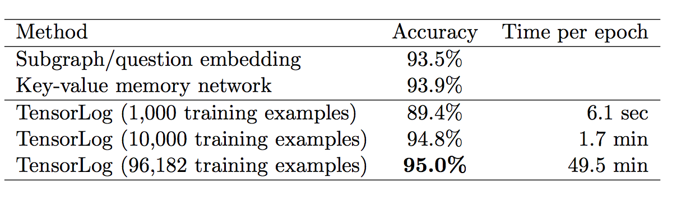
Experiment: Factual Q/A with a KB
KG is about 420k movie facts + 850k facts about the questions (mentions_entity/2, features/2)

Slide 50
Joint entity-linking and QA
proposed extension
answer(Question,Answer) :-
classification(Question,aboutActedIn),
mentionsEntity(Question,Entity), actedIn(Answer,Entity).
answer(Question,Answer) :-
classification(Question,aboutDirected),
mentionsEntity(Question,Entity), directed(Answer,Entity).
answer(Question,Answer) :-
classification(Question,aboutProduced),
mentionsEntity(Question,Entity), produced(Answer,Entity).
...
mentionsEntity(Question,Entity) :-
containsNGram(Question,NGram), matches(NGram,Name),
possibleName(Entity,Name), popular(Entity).
classification(Question,Y) :-
containsNGram(Question,NGram), indicatesLabel(NGram,Y).
matches(NGram,Name) :-
containsWord(NGram,Word), containsWord(Name,Word), important(Word).

Slide 51
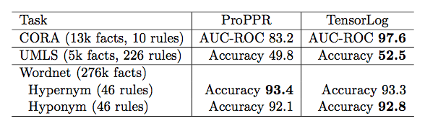
Experiment: Relational Learning Benchmarks
Theories all learned using ISG (Wang et al, CIKM 2014) and then fixed

Slide 52
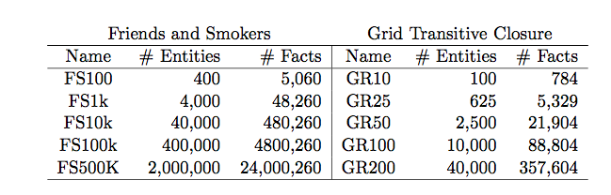
Experiment: Scalability of Inference
shallow inference task
deeply recursive inference task

Slide 53
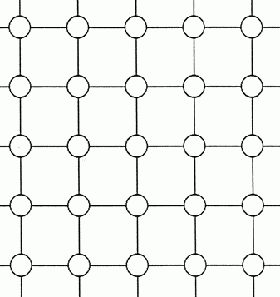
Experiment: Scalability of Inference
edge(cell_2_3, cell_2_4) 0.2
...
cell_2_3
cell_2_4
path(X,Y) :- edge(X,Y)
path(X,Z) :- edge(X,Z),path(Z,Y)

Slide 54
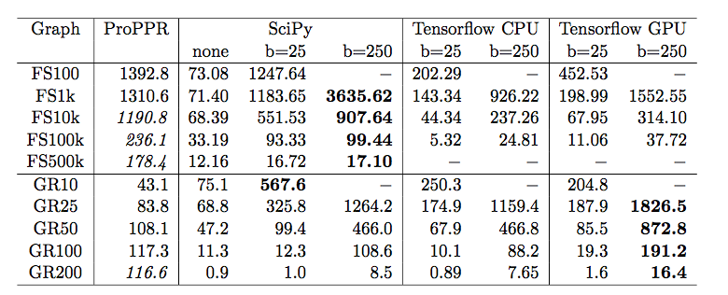
Experiment: Scalability of Inference
shallow
Queries per second: machine with one GPU
eg on query -? path(cell_2_4,Y)
bold is best TensorLog performer - ProPPR italicized if it “wins”
recursive

Slide 55
Experiment: Scalability of Inference
shallow
Queries per second: machine with one GPU
bold/italics is best performer
b=25 means that 25 queries are done in parallel (as a “minibatch”)
minibatch paralellization gives large - up to 10x - speedup on one core
recursive

Slide 56
Experiment: Scalability of Inference
shallow
Queries per second: machine with one GPU
bold/italics is best performer
b=25 means that 25 queries are done in parallel (as a “minibatch”)
Compared TensorFlow and homegrown sparse matrix backends ...
recursive

Slide 57
Experiment: Scalability of Inference
shallow
Queries per second: machine with one GPU (Titan X, 12Gb)
bold/italics is best performer
b=25 means that 25 queries are done in parallel (as a “minibatch”)
Tested TensorFlow and hand-constructed sparse matrix backends
Tested TensorFlow with GPU: only 1.5-2x faster for inference and then only on deeper models
recursive

Slide 58
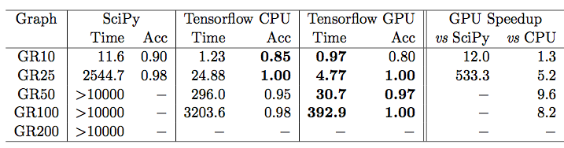
Experiment: Scalability of Learning
Task: learn grid transition weights so that transitive closure operations perform a particular navigational goal
Go from cell to closest “landmark” cell, like (10,10) or (30,50)
Minibatch size of 25
A 25 by 25 grid
Learning is much faster with TensorFlow and with GPUs
Architected for learning/repeated passes over data with same code

Slide 59
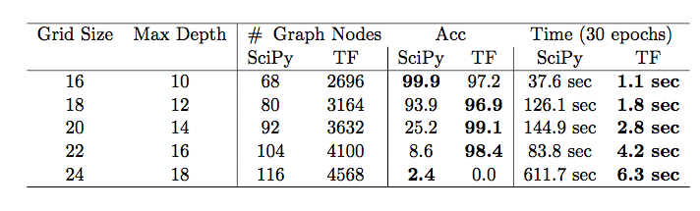
Experiment: Robustness of Learning
Tune parameters on 16x16 grid task
Run same parameters on larger grids (deeper inference, different architecture networks)
Compare homegrown gradient descent and well-tuned Adagrad (Tensorflow implementation)
Adagrad is more robust and faster

Slide 60
Tensorlog:
Extensions

Slide 61
Experiment: Learning Other Semantics
Inference is now via a numeric function: y = g_{io}^{uncle}(u_{a})
y encodes {b:uncle(a,b)} is true and y[b]=confidence in uncle(a,b)
Define loss function relative to target proof-count values y* for x, eg
loss(g_{io}^{uncle}(u_{a}), y*) = crossEntropy(softmax(g(x)),y*)
softmax normalizes the proof counts y
so you learn a conditional distribution P(y|x)
i.e. sum of y’s will be 1.0
can rank people by confidence in being “Bob’s uncle” but can’t tell how many uncles Bob has
(but it’s great to optimize!)

Slide 62
Key point: flexibility is free
Adding logistic
regression
“on top” of TensorLog
Inference is now via a numeric function: y = g_{io}^{uncle}(u_{a})
y encodes {b:uncle(a,b)} is true and y[b]=confidence in uncle(a,b)
Define loss function relative to target proof-count values y* for x, eg
loss(g_{io}^{uncle}(u_{a}), y*) = crossEntropy(sigmoid(g(x) + b), y*)
Alternative: convert weighted proofcounts to an arbitrary distribution - e.g. with a biased sigmoid - and assess loss relative to that. Loss function changes, learning still “free”.
Then you can learn to match an arbitrary target distribution.

Slide 63
Example: alternative semantics
Recall proof-counting was compared to model-counting systems (eg ProbLog2) where conceptually
There is a distribution Pr(KG) over KGs
Tuple-independence: draw a KG by picking each fact f with probability w_{f}
The probability of a fact f’ is the probability T+KG’ implies f’, for a KG’ is drawn from Pr(KG)
Experiments: for grid world, estimate Pr(path(a,b)) using a sample of 1M random KG/grids drawn from the tuple-independence model

Slide 64
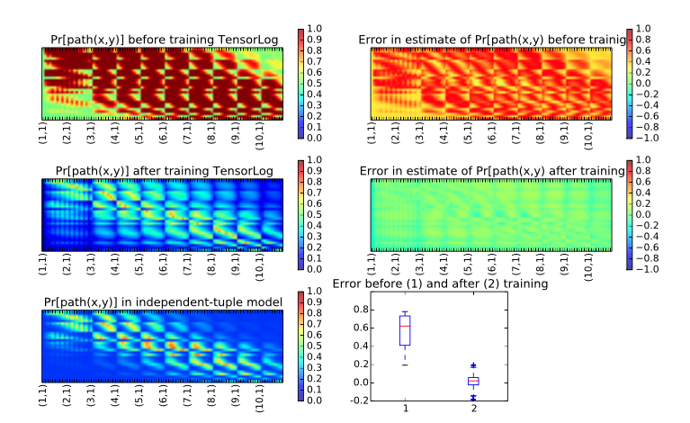
Experiment: Learning Alternate Semantics
Experiment: learn grid-transition weights to approximate ProbLog2’s inference weights.
Error drops by factor of 10x.

Slide 65
Experiment: Learning Alternate Semantics
Experiment: learn grid-transition weights to approximate ProbLog2’s inference weights.
Error drops by factor of 10x.

Slide 66
Experiment: Learning Representations
edge(cell_2_3, cell_2_4) 0.2
...
cell_2_3
Replace learnable weight 0.2 with a function of learned representations of cell_2_3 and cell_2_4.
Each cell i has a learned vector representation ei
cell_2_4
path(X,Y) :- edge(X,Y)
path(X,Z) :- edge(X,Z),path(Z,Y)

Slide 67
Experiment: Learning Representations
Experiment: learn a neural model for grid-transition weights.
edge(cell1, cell2) =
log(1 + exp(sum_d (e1[d] - e2 [d])) * M[cell1,cell2]
makes edge score positive
Averaged over 10 trials, 10x10 grid, 100 epochs.
Accuracy 97.8%
Accuracy of baseline: 85.8%
(one weight per edge)
0,1 mask so only grid edges are considered
Manhattan distance in embedding space, but directional: want weights to encourage transitions toward the target cell.

Slide 68
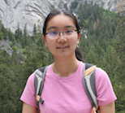

Tensorlog:
Extension (Neural ILP)
Fang Yang, Zhilin Yang

Slide 69
Learning rules for TensorLog
Given only examples:
uncle(liam,Y): Y should be {“bob”}
aunt(liam,Y):Y should be {“mary, “sue”}
…
Learn full model (parameters and rules)
Basic idea:
TensorLog programs are compiled to a sequence of differentiable operators
Each operator is applied to a memory location ~= logical variable
Learn sequence with a neural controller

Slide 70
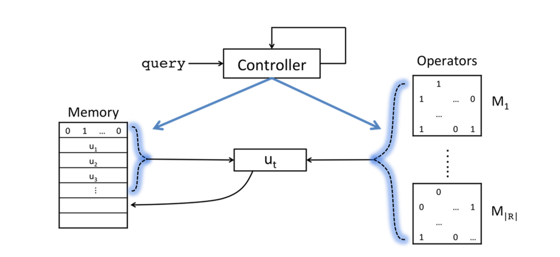
Learning rules for TensorLog
Final output is attention over memory cells after T steps
LSTM controller: reads p,a at each time step in computing Y : p(a,Y)
Current status:
chain rules only,
hard KB
New memory cell allocated at each time step: contents are formed by attention over ops and previous memory cells

Slide 71
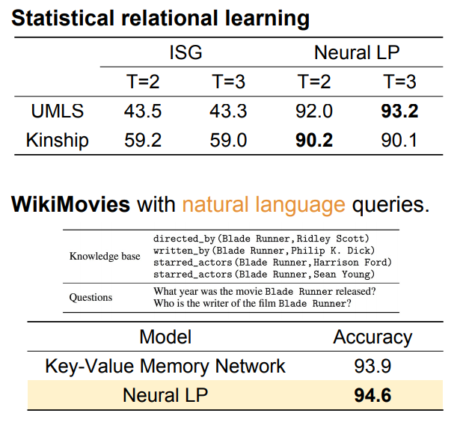

Slide 72
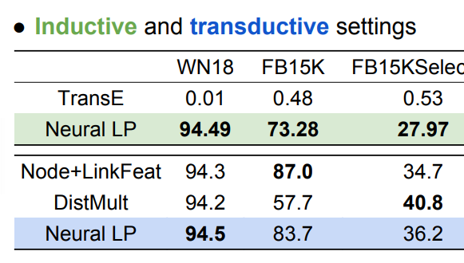
Results for Neural Inductive Logic Programming

Slide 73
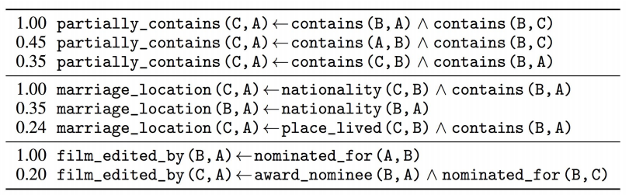
Recovering rules for Neural ILP

Slide 74
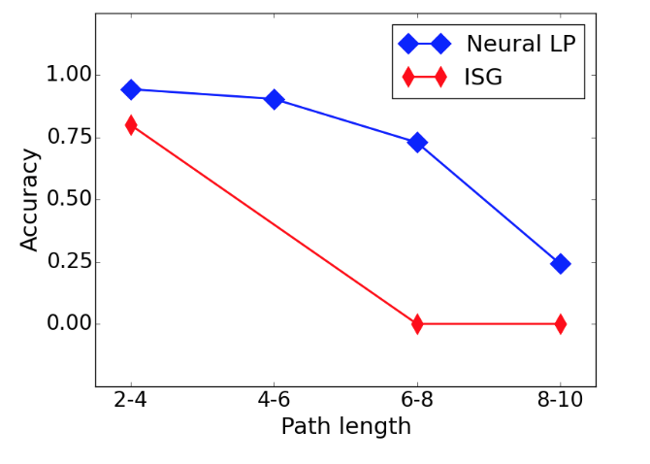
Results for Neural Inductive Logic Programming
Synthetic task: learning specific long paths in grid, like “NE-NE-S-S”

Slide 75
Where to next?
William Cohen
Google AI

Slide 76
TensorLog model
who acted in the movie Wise Guys? ['Harvey Keitel', 'Danny DeVito', 'Joe Piscopo', …]
what is a film written by Luke Ricci? ['How to Be a Serial Killer']
…
starred_actors Wise Guys Harvey Keitel
starred_actors Wise Guys Danny DeVito
starred_actors Wise Guys Joe Piscopo
starred_actors Wise Guys Ray Sharkey
directed_by Wise Guys Brian De Palma
has_genre Wise Guys Comedy
release_year Wise Guys 1986
…
written_by How to .. Killer Luke Ricci
has_genre How to .. Killer Comedy
...
answer(Question, Entity) :-
mentions_entity(Question,Movie),
starred_actors(Movie,Entity),
feature(Question,F),weight_sa_io(F).
% w_sa_f: weight for starred_actors(i,o)
...
answer(Question, Movie) :-
mentions_entity(Question,Entity),
written_by(Movie,Entity),
feature(Question,F),weight_wb_oi(F).
...
Total: 18 rules

Slide 77
TensorLog model
Is this the best interface to give Google programmers to build models? Problems:
Hard to predict what will happen in the compiled model (what does the BP stage do to construct a model?)
Hard to quantify over relations (do second order reasoning)
Awkward to swap back and forth between TensorFlow and TensorLog (declarative vs functional)
Proposal: language for compilation target for Tensorlog
answer(Question, Entity) :-
mentions_entity(Question,Movie),
starred_actors(Movie,Entity),
feature(Question,F),weight_sa_io(F).
% w_sa_f: weight for starred_actors(i,o)
...
answer(Question, Movie) :-
mentions_entity(Question,Entity),
written_by(Movie,Entity),
feature(Question,F),weight_wb_oi(F).
...

Slide 78
NQL: semantics in Tensorflow
variable/expression output x | a vector encoding a weighted set (localist representation)
nq.one(‘bob’,’person’) x.jump_to(‘bob’,’person’) | v_bob, one hot vector for entity ‘bob’
nq.all(‘person’) x.jump_to_all(‘person’) | k-hot vector for set off all elements of type ‘person’ i.e. a ones vector
nq.none(‘person’) x.jump_to_none(‘person’) | k-hot vector for empty set of elements of type ‘person’ i.e. a zeros vector
x.r() x.follow(‘r’) | x.dot(M_r) where M_r is sparse matrix for r and x a k-hot vector
x | y x + y | x + y
x & y x * y | x * y Hadamard aka component-wise product
x.filtered_by(‘r’,’bob’) x.weighted_by(‘r’,’bob’) | x * v_bob.dot(M_r’) M_r’ is transpose
x.if_exists(y) x.weighted_by_sum(y) | x * y.sum()

Slide 79
Neural Query Language
-1: go “backwards”
mode oi
answer =
question.mentions_entity().starred_actors().if_exists(
question.feature() & nq.one(‘starred_actors’).indicates(-1))
| question.mentions_entity().directed_by().if_exists(
question.feature() & nq.one(‘directed_by’).indicates(-1))
|
….
answer(Question, Entity) :-
mentions_entity(Question,Movie),
starred_actors(Movie,Entity),
feature(Question,F),
indicates(F,’starred_actors’).
...
answer(Question, Movie) :-
mentions_entity(Question,Entity),
written_by(Movie,Entity),
feature(Question,F),
indicates(F,’written_by’)
...
“features that indicate the ‘starred_actors’ KG relation”
“features that indicate the ‘directed_by’ KG relation”
x.if_exists(y): return vector x multiplied by sum of weights in y … a soft version of return x iff y is non-empty else empty set

Slide 80
Neural Query Language: 1st-order
answer =
question.mentions_entity().starred_actors(+1).if_exists(
question.feature() & nq.one(‘starred_actors’).indicates_rel(-1)).if_exists(
question.feature() & nq.one(‘forward’).indicates_dir(-1)))
| question.mentions_entity().starred_actors(-1).if_exists(
question.feature() & nq.one(‘starred_actors’).indicates_rel(-1)).if_exists(
question.feature() & nq.one(‘backward’).indicates_dir(-1)))
….
answer(Question, Entity) :-
mentions_entity(Question,Movie),
starred_actors(Movie,Entity),
feature(Question,F),
indicates_rel(F,’starred_actors’),
indicates_dir(F,’forward’).
...

Slide 81
Neural Query Language: 2nd-order
def kg_relation(question):
return question.features().feat2rel() % classify relation
def answer(question):
return question.mentions_entity().follow(kg_relation(question))
verb(t37,starred_in)
starred_in(tom_hanks,the_post) → subject(t37,tom_hanks)
object(t37,the_post)
x.follow(g) == (x.subject(-1) & g.verb(-1)).object()
x={tom_hanks} g={starred_in}: (tom_hanks is sub) & (starred_in is verb) → object

Slide 82
Conclusions and Wrap-Up

Slide 83
Conclusions and Wrap-Up

Slide 84
Conclusions and Wrap-Up
How should logic and logic programming approaches to AI be integrated with “neural” / “deep” / GPU-based approaches to AI?

Slide 85
Conclusions and Wrap-Up
How should logic and logic programming approaches to AI be integrated with “neural” / “deep” / GPU-based approaches to AI?
TensorFlow tries to answer this in one way:
Scalable - but restricted - declarative subset of Prolog
Very efficient for learning and inference
Combinable with neural methods:
Eg: Logistic regression model “on top” of proof counts (for tuple-independence)
Eg: Representation learning “underneath” (to define edge weights)

Slide 86
Conclusions and Wrap-Up
How should logic and logic programming approaches to AI be integrated with “neural” / “deep” / GPU-based approaches to AI?
Lots of other approaches are out there
End-to-End Differentiable Proving (Rocktäschel & Riedel, NIPS 2017)
Learning Explanatory Rules from Noisy Data (Evans & Grefenstette, JAIR 2018)
DeepProbLog: Neural Probabilistic Logic Programming (Mahaeve et al, 2018)

Slide 87
backup slides

Slide 88
Aren’t there many neural implementations of logic?
KBANN idea (1991): convert every DB fact, and every possible inferable fact, to a neuron.
Similar “grounding strategies” are used by many other soft logics: Markov Logic Networks, Probabilistic Soft Logic, …
A neuron for every possible inferable fact is “too many” --- i.e., bigger than the DB.

Slide 89
Reasoning in PrDDBs/PrDKGs
uncle(liam,dave)
uncle(liam,eve)
uncle(liam,chip)
possible inferences
(Herbrand base)
σ(….)
σ(….)
σ(….)
child(liam,eve)
brother(eve,chip)
DB facts
child(liam,bob)
usual approach: “grounding” the rules

Slide 90
Reasoning in PrDDBs/PrDKGs
explicit grounding does not scale!
Example: inferring family relations like “uncle”
N people
N² possible “uncle” inferences
N = 2 billion ➔ N² = 4 quintillion
N = 1 million ➔ N² = 1 trillion
A KB with 1M entities is small

Slide 91
Reasoning in TensorLog
TensorLog uses a knowledge-graph specific trick to get scalability:
“reasoning” means answering a query like: find all Y for which p(a,Y) is true for some given predicate p;query entity a; and theory T and KG)
inferences for a logical theory can be encoded as a bunch of functions: for every p, a, a vector a encodes a, and the function f_{p}(a) returns a vector encoding answers y (and confidences)
actually we have functions for p(a,Y) and p(Y,a)…. called f_{p:io}(a) and f_{p:oi}(a)
we’ll use dynamic programming to proof-count a restricted class of programs

Slide 92
Reasoning in TensorLog
Example: inferring family relations like “uncle”
N people
N² possible “uncle” facts
N = 1 million ➔ N² = 1 trillion
f₁(x) = Y f₂(x) = Y
The vectors are size O(N) not O(N²)
x is the nephew
x is the uncle
(0,0,0.81,0,0,0.93,0,0,0)
one-hot vectors
(0,0,0,1,0,0,0)
vectors encoding
weighted set of DB instances

Slide 93
Reasoning in TensorLog
TensorLog uses a knowledge-graph specific trick…functions from sets of entities to sets of entities
Key idea to enable fast proof-counting: You can describe the reasoning process as a factor graph
Example: Let’s start with some example one-rule theories

Slide 94
Reasoning via message-passing: example
Query: uncle(liam, Y) ?
Algorithm: build a factor graph with one random variable for each logical variable, encoding a distribution over DB constants, and one factor for each logical literal.
Belief propagation on factor graph enforces the logical constraints of a proof, and gives a weighted count of number of proofs supporting each answer
uncle(X,Y):-parent(X,W),brother(W,Y)
X
W
brother
Y
parent
…
[liam=1]
[eve=0.99,bob=0.75]
[chip=0.99*0.9]
output msg for brother is sparse mat multiply: v_{W} M_{brother}

Slide 95
Reasoning via message-passing: subpredicates
Query: uncle(liam, Y) ?
uncle(X,Y):-aunt(X,W),spouse(W,Y)
aunt(X,Y):-parent(X,W),sister(W,Y)
Recursive predicate calls can be expanded in place in the factor graph
Stop at a fixed maximum depth (and return count of zero proofs)
X
W
spouse
Y
aunt
…
X’
W’
sister
Y’
parent

Slide 96
Reasoning via message-passing: subpredicates
Query: uncle(liam, Y) ?
uncle(X,Y):-aunt(X,W),spouse(W,Y)
aunt(X,Y):-parent(X,W),sister(W,Y)
Recursive predicate calls can be expanded in place in the factor graph
Multiple clauses for the same predicate: add the proof counts for each clause
X
W
spouse
Y
aunt
X’
W’
sister
Y’
parent
sum
X’’
W’
spouse
Y’’
uncle

Slide 97
Reasoning via message-passing: key ideas
Query: uncle(liam, Y) ?
General case for p(c,Y):
initialize the evidence variable X to a one-hot vector for c
wait for BP to converge
read off the message y that would be sent from the output variable Y.
un-normalized probability
y[d] is the weighted number of proofs supporting p(c,d)
uncle(X,Y):-child(X,W),brother(W,Y)
X
W
brother
Y
child

Slide 98
Reasoning via message-passing: key ideas
Special case:
If all clauses are polytrees (~= every free variable has one path of dependences linking it to a bound variable) then BP converges in linear time and will result in a fixed sequence of messages being passed
Only a few linear algebra operators are used in these messages:
vector-matrix multiplication
Hadamard product
multiply v1 by L1 norm of v2
vector sum
(normalization)

